Slide 1
Lexis Surfaces

Slide 2
Lexis Surfaces
make you more civilised

Slide 3
The mark of a civilized man is his ability to look at a column of numbers and weep

Slide 4
The mark of a civilized person is their ability to look at a column of numbers and weep

Slide 5
The mark of a civilized person is their ability to look at a column of numbers and respond emotionally

Slide 6



Who am I?

Slide 7
What’s a Lexis Surface?

Slide 8
A map

Slide 9
What’s a map?

Slide 10
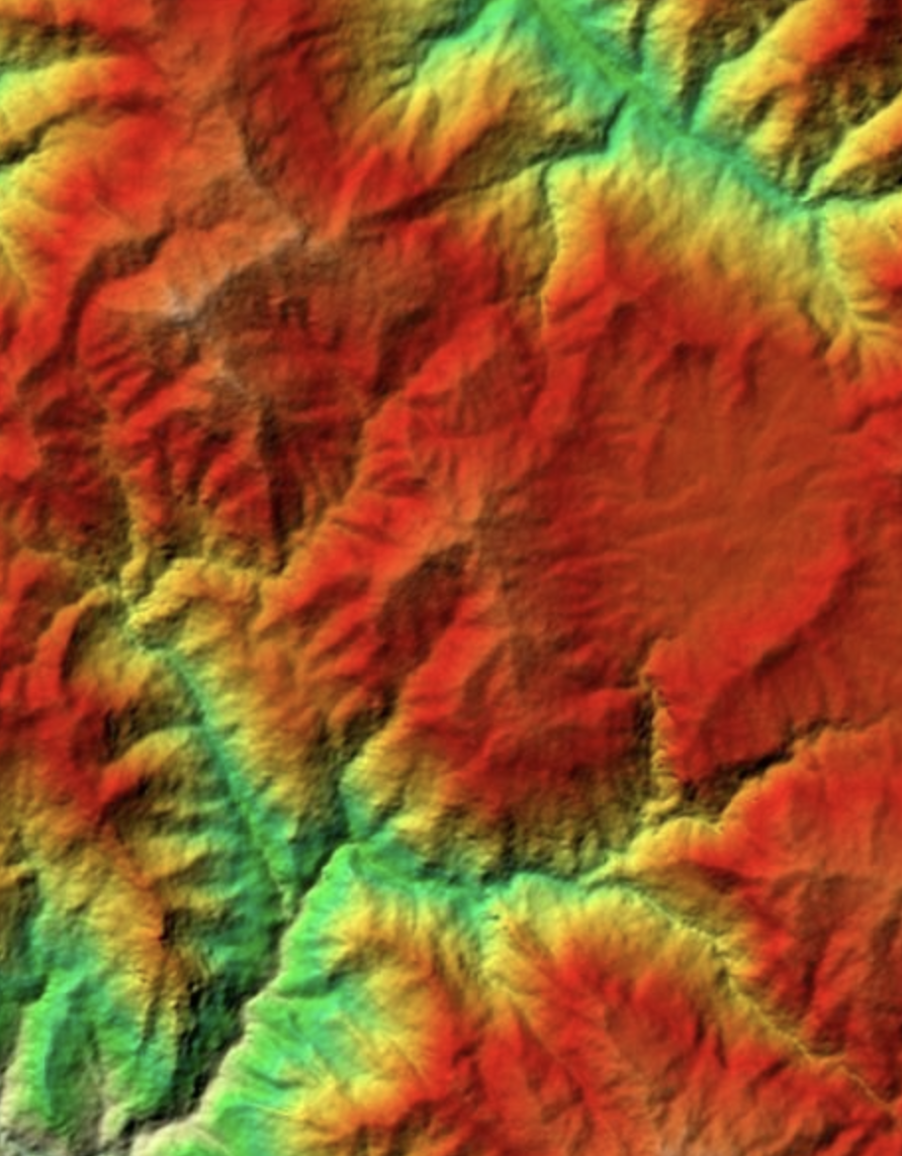

$$λ$$
Source: https://gis.stackexchange.com/questions/294045/how-do-you-get-a-color-topographic-map-in-google-earth-using-the-altitude-provid

Slide 11

$$λ$$

Slide 12
$$λ$$
Latitude | Longitude | Elevation

Slide 13
$$λ$$
Latitude | Longitude | Elevation
X position
Y position
Colour/Shade

Slide 14
$$λ$$
Year | Age | {Value}
X position
Y position
Colour/Shade

Slide 15
Values could be:
Simple
(Log) Mortality rate
Conditional life expectancy
Population size
Fertility rate
Less Simple:
Differences between two populations
Differences between observed and expected
Year | Age | {Value}
X position
Y position
Colour/Shade

Slide 16
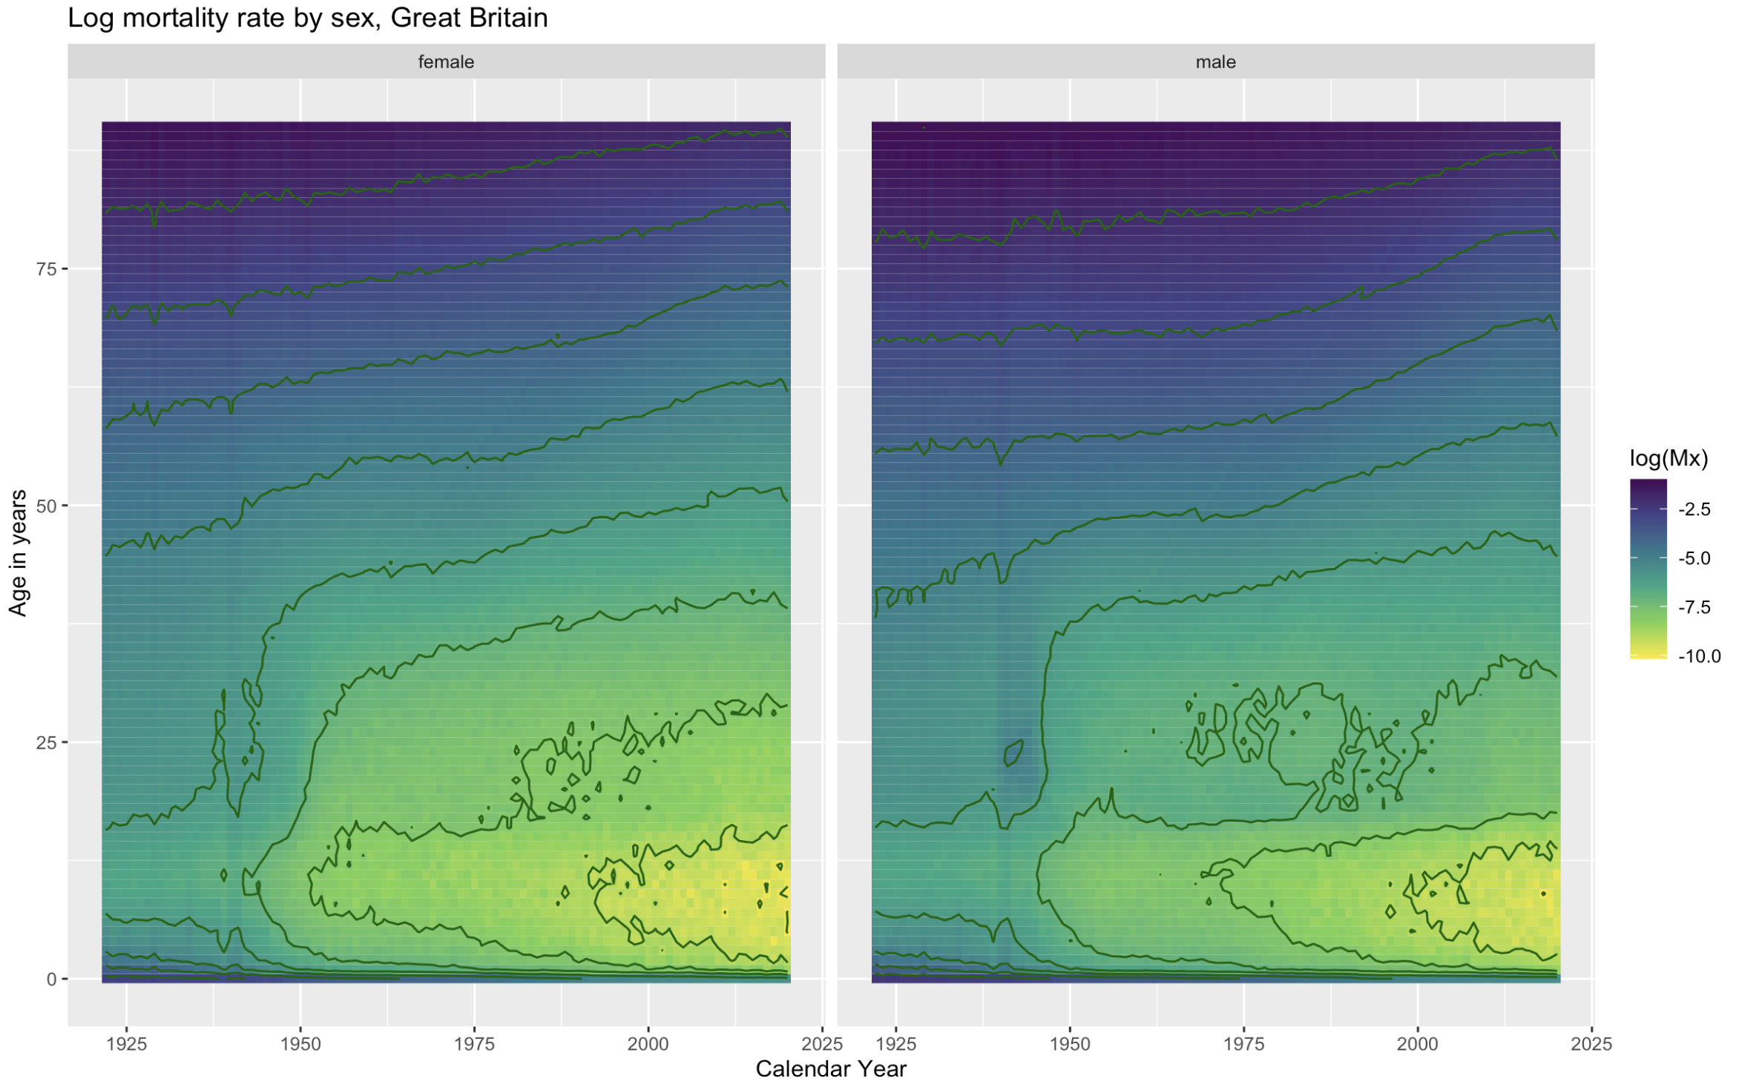

Slide 17
WARNING: CONTOUR LINES ARE NOT LIKE MOST OTHER LINES…

Slide 18
From Seeing to Modelling: Northern Ireland Excess Mortality

Slide 19
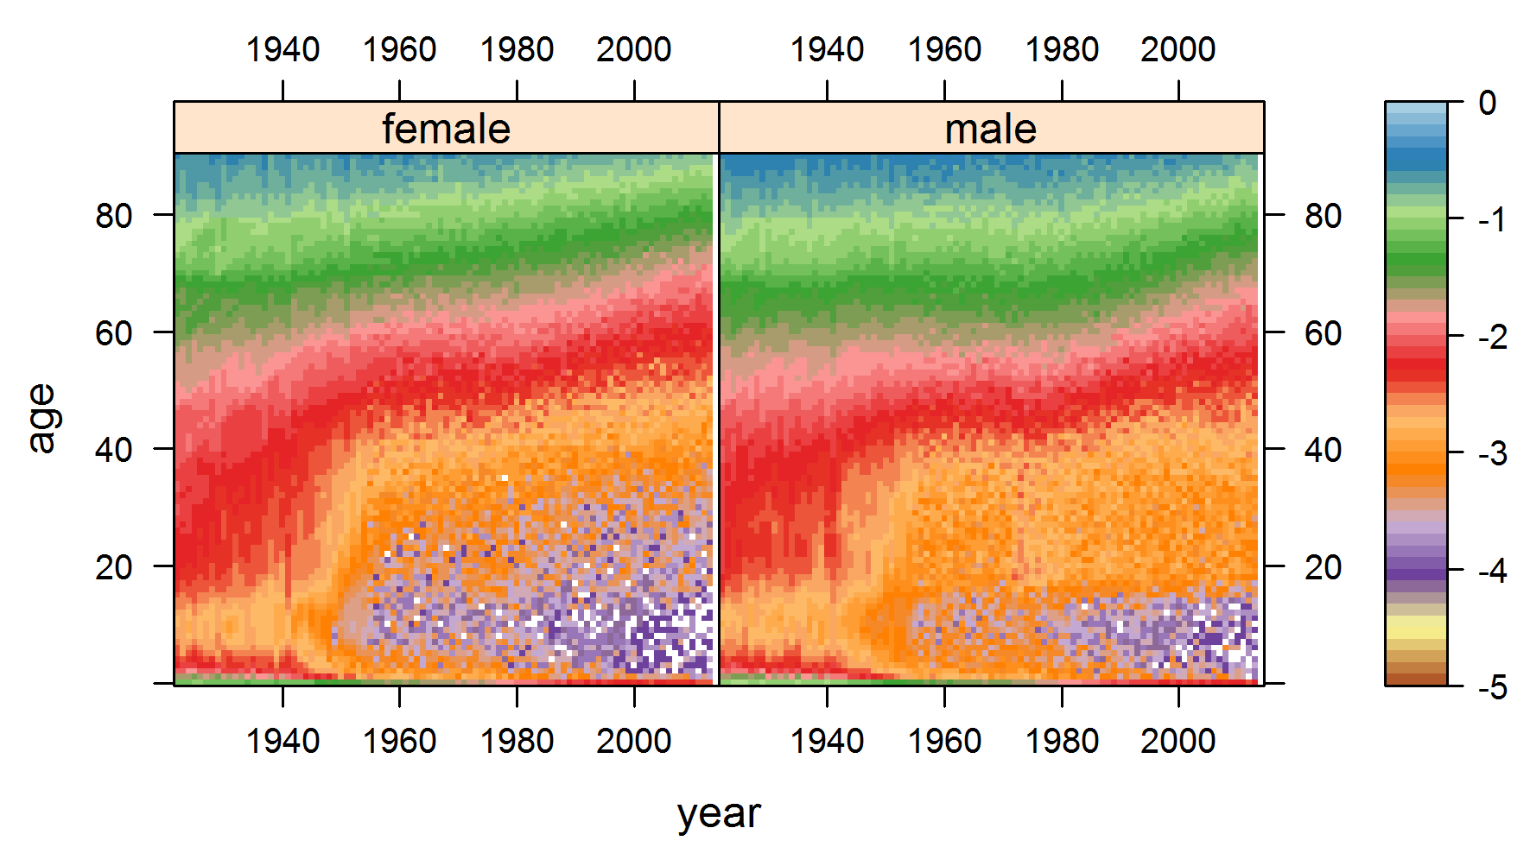

Slide 21
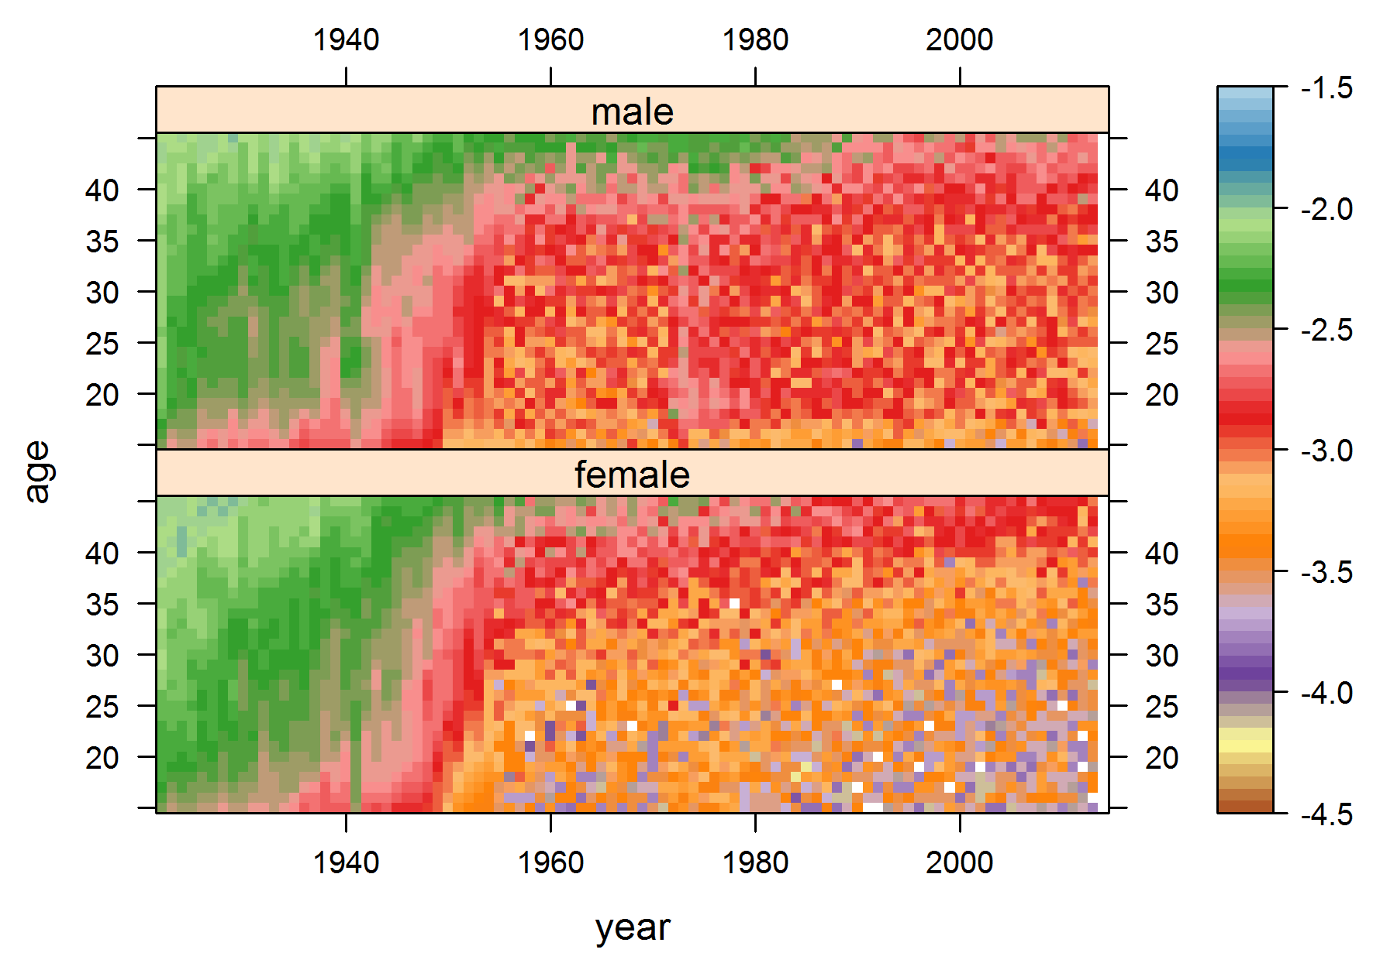

Slide 22
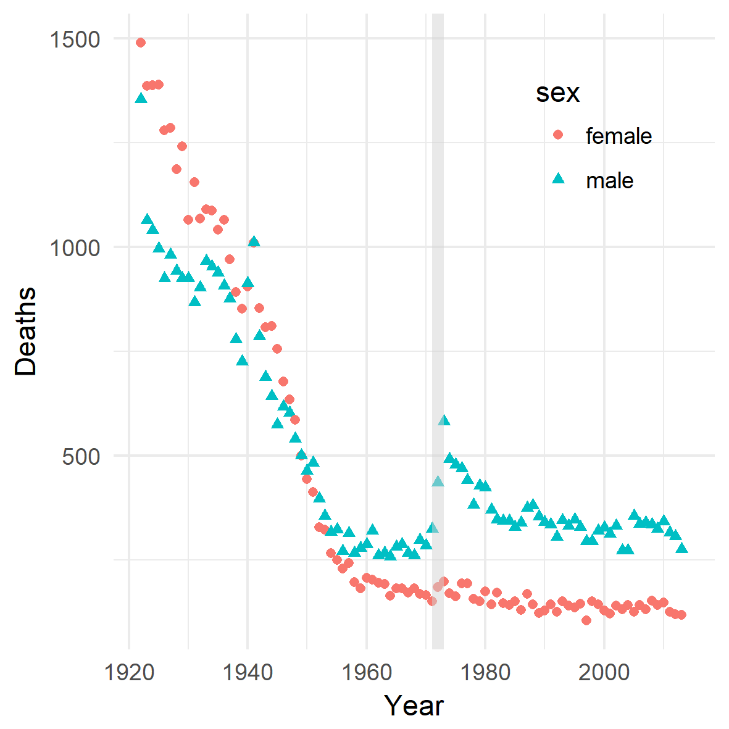

Slide 23
Apparent excess deaths

Slide 24
Apparent excess deaths
When? (time)

Slide 25
Apparent excess deaths
When? (time)
‘Where’? (age groups)

Slide 26
Apparent excess deaths
When? (time)
‘Where’? (age groups)
Compared to what? (counterfactual)

Slide 27
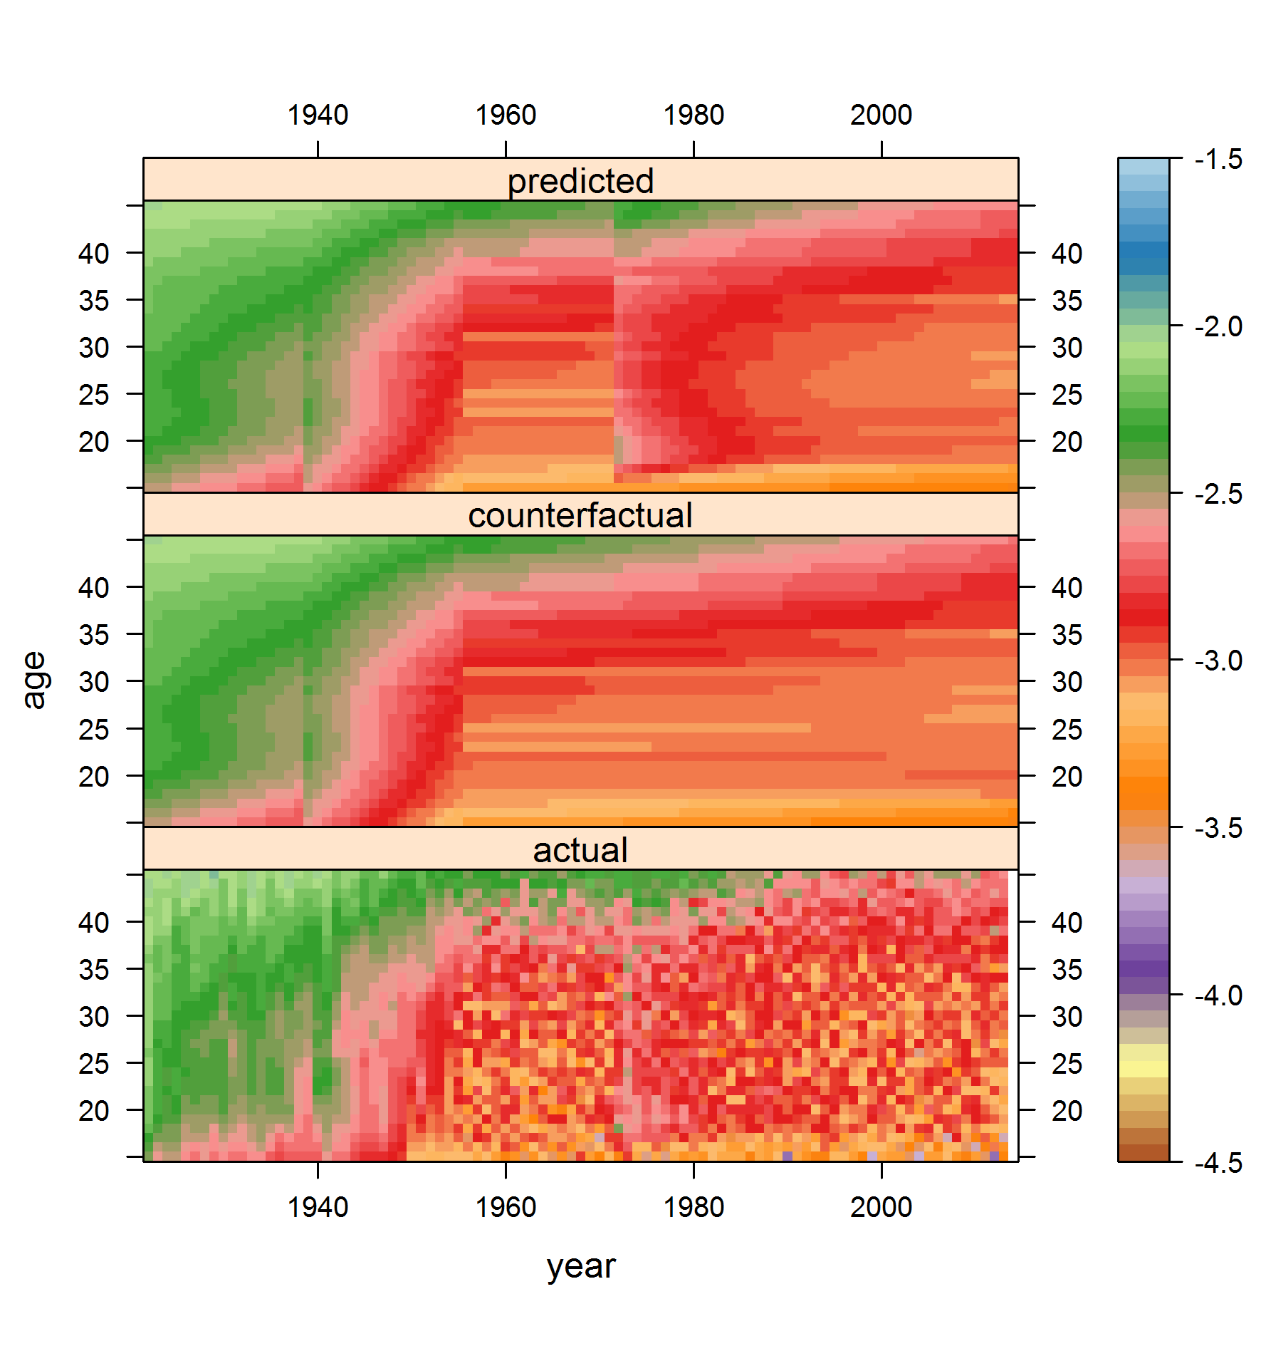

Slide 28
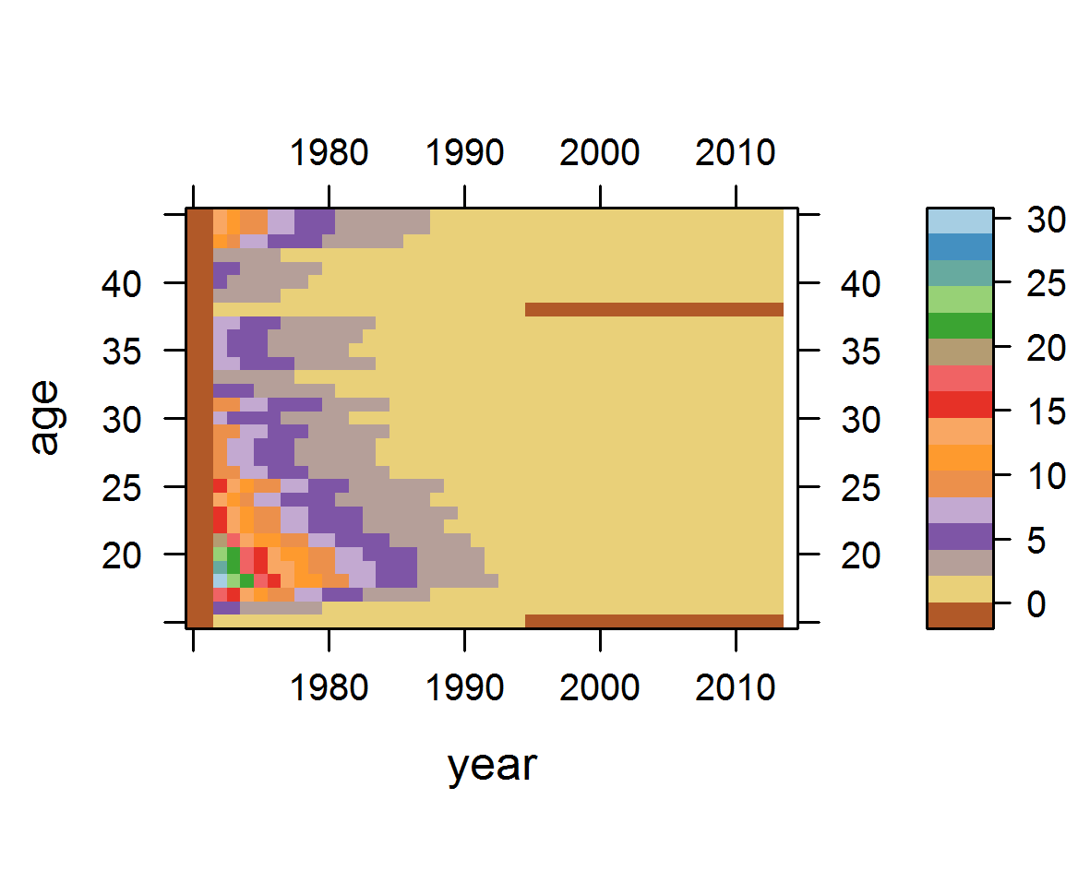

Slide 29

$$\sum{excess deaths }=2776$$
by 2013
Troubles death estimates: ~3500-3700
Within around 20%
Not quite comparing like-with-like
Could some lives have been saved by the Troubles?
E.g. Traffic stops?

Slide 30

Source: https://www.masterclass.com/articles/guide-to-classic-palate-cleansers

Slide 31
Interactive Lexis Surfaces: Grand Tours with HMDHFDplus, Shiny, and Plotly

Slide 32
Events
Events
Events

Slide 33
Selection Events
Events
Events

Slide 34
Selection Events
Hover-over Events
Events

Slide 35
Selection Events
Hover-over Events
Click-on Events

Slide 36


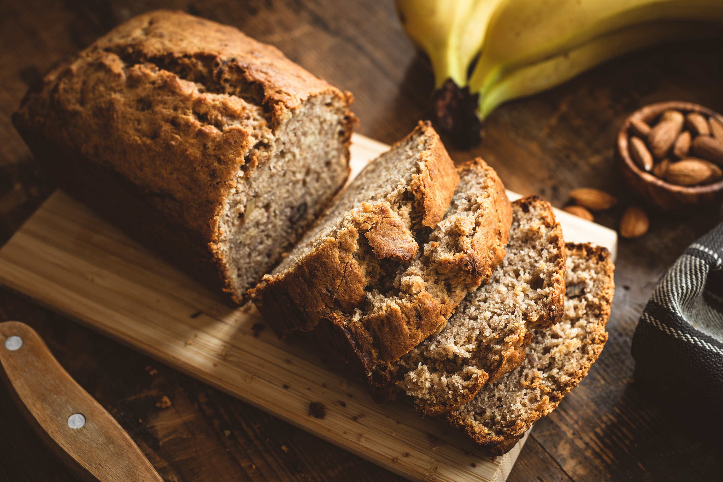

Slide 37
https://datascapes.shinyapps.io/hmd_explorer/

Slide 38

Selection Events
Hover-over Events
Click-on Events

Slide 39

Selection Events
Hover-over Events
Click-on Events
Maintainability

Slide 40
Lexis Surfaces
make you more civilized by turning columns of numbers into data landscapes

Slide 41
Final Thought
R and Friends
or
R and Frenemies?

